Slide 1
Secure data hiding in images using steganography
CAPSTONE PROJECT
Presented By: Khushi Kumari
Student Name: Khushi Kumari
College Name: Indira Gandhi National Open University, New Delhi
Department: Computer Applications

Slide 2
OUTLINE
Problem Statement
Technology used
Wow factor
End users
Result
Conclusion
Git-hub Link
Future scope

Slide 3
Problem Statement
The Main problem of sharing data between the users is interference of the unauthorized users or parties.
The Main aim of the communication over a network is that the data is shared between the users is must be secured and safely transferred.
The purpose of making encryption and decryption accessible to non-technical users through a simple interface to hide confidential information.

Slide 4
Technology used
Programming Language: Python
Image Processing Library: OpenCV
File Handling & Security: Basic encryption logic for password protection
Platform: Windows 11

Slide 5
Wow factors
Provides a secure and user-friendly way to encrypt and decrypt messages within images using steganography and password protection.
The message is embedded inside an image using OpenCV and can Only be retrieved with correct password.
Works on any standard image file format.

Slide 6
End users
Cyber security Enthusiasts – Exploring secure communication techniques.
Government & Defense – Secure message transmission without raising suspicion.
Journalists & Activists – Concealing sensitive information in images to avoid surveillance.
Software Developers - Learning steganography concepts and their applications.

Slide 7
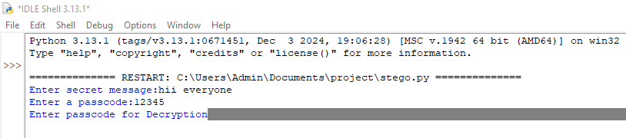
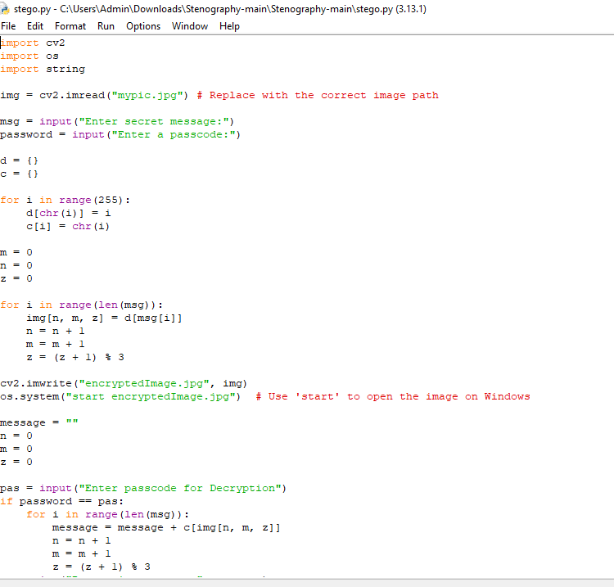
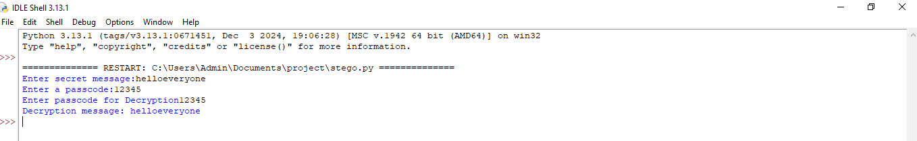
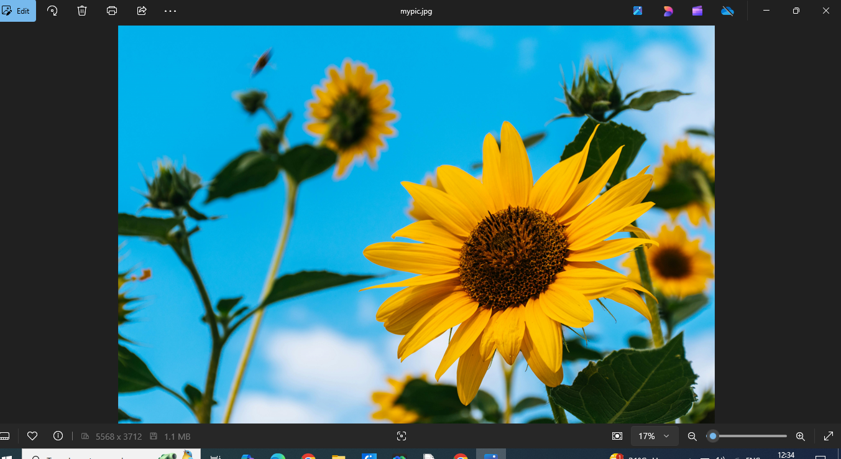

Results
Code:
Input Image File:
Output Image File:

Slide 8
Conclusion
Steganography provides a covert way of communicating sensitive information.
This project showcases a simple yet effective implementation of message hiding in images.
Future improvements can make it more robust, secure, and scalable.

Slide 9
GitHub Link
Make sure that there should be readme file

Slide 10
Future scope(optional)
Advanced Encryption Techniques – Integrate AES encryption before embedding text in images.
Support for Audio & Video Steganography – Expanding beyond images.
AI-based Detection Prevention – Ensuring messages stay undetectable from modern forensic tools.
Mobile App & Web Version – Expanding accessibility beyond desktops.
Multi-Layer Security – Combining steganography with blockchain for ultra-secure communication.

Slide 11
THANK YOU

